Slide 1
Analysis of Algorithm

Slide 2
Algorithm
Finite no: of steps to solve a problem.
Characteristics of Algorithm
Input
Output
Definiteness
Finiteness
Effectiveness

Slide 3
Analysis of Algorithm
It is processing or compairing 2algorithms with respect to time, space etc
For a given problem, which algorithm is best.
How much time/ space the algorithm takes to run

Slide 4
Example
Searching an element in an array(Array, x)
Case 1: x is the first element in the array(Best Case)
Number of comparisons=1
Case 2: x is not present( Worst Case)
Number of comparisons= n
Depends on size of input
Case 3: x is in middle (Average Case)
Number of comparisons=n/2

Slide 5
Analysis of Algorithms
Priori Analysis
Analysis before execution.
It is independent of hardware.
Will give approximate answer.
Posteriori Analysis
Done after execution of an algorithm.
Dependent on language ,type of hardware
Give exact answer.

Slide 6
RAM MODEL
Machine independent algorithm design depends upon a hypothetical computer called Random Access Machine or RAM Model
To find the best algorithm, we measure the run time of an algorithm by counting up number of steps it takes on a given problem instance.
Number of steps an algorithm takes for a given input will decide the run time of algorithm

Slide 7
Comparison
WORST CASE | BEST CASE | AVERAGE CASE
Input for which the algorithm takes maximum time to find a solution | Input for which the algorithm takes minimum time to find a solution | Input for which the algorithm takes average time to find a solution
For this input, there will be slowest Execution of Algorithm | For this input, algorithm executes faster | For this input, Algorithm executes on an average
Best case<=Average case<=Worst case

Slide 8
RAM MODEL of Computation
Each simple operation takes exactly one step
Each memory access takes exactly one step
Loops and subroutines are not considered simple operations instead they are composition of many single step operation.
The time it takes to run through a loop or execute a subprogram depends upon the number of loop iterations or the specific nature of subprogram.

Slide 9
Frequency Count
By expressing the running time of algorithm as function of input size n f(n) & compare these different function corresponding to running time.
Function is independent of hardware and language

Slide 10
Example
F(n) =2n+3, O(n)
Space
A=n
N=1
S=1
i=1
S(n) =n+3, O(n)
Algorithm sum(A, n)
{
S=0
For(I=0;I<n;I++)
{
S=S+A[I]
}
Return s
}
1
N+1
N
1

Slide 11
Example
Swap 2numbers
Start
Read 2numbers num1, num2
T=num1
num1=num2
num2=T
Print num1, num2
F(n) =5 O(n) =1
S(n) =3words O(n) =1

Slide 12
Example
F(n) =2n^2+2n+1
Function is of order n^2
Space
A=n^2
B=n^2
C=n^2
N=1
I=1
J=1
S(n) =3n^2+3
Is of order n^2
Algorithm Add(A, B, n)
for(I=0;I<n;I++)
{
for(j=0;j<n;j++)
{
C[I][j]=A[I][j]+B[I][j]
}
}
N+1
N*N+1
N*N

Slide 13
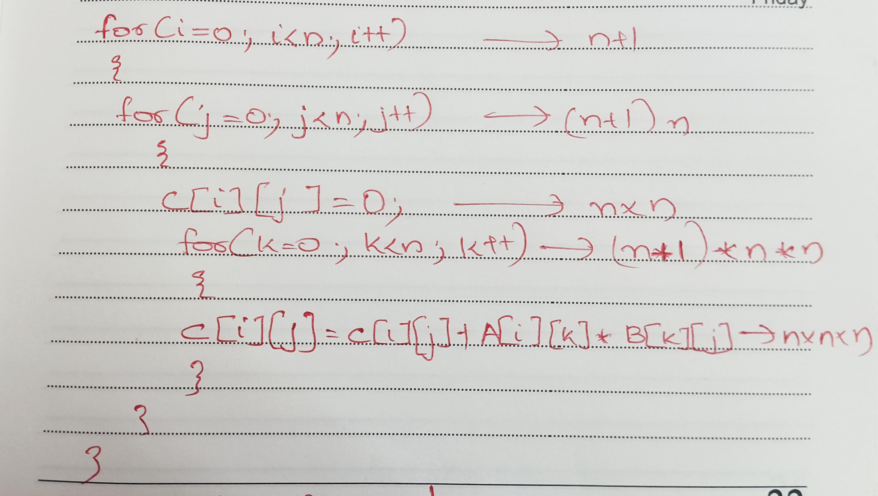
Example

Slide 14
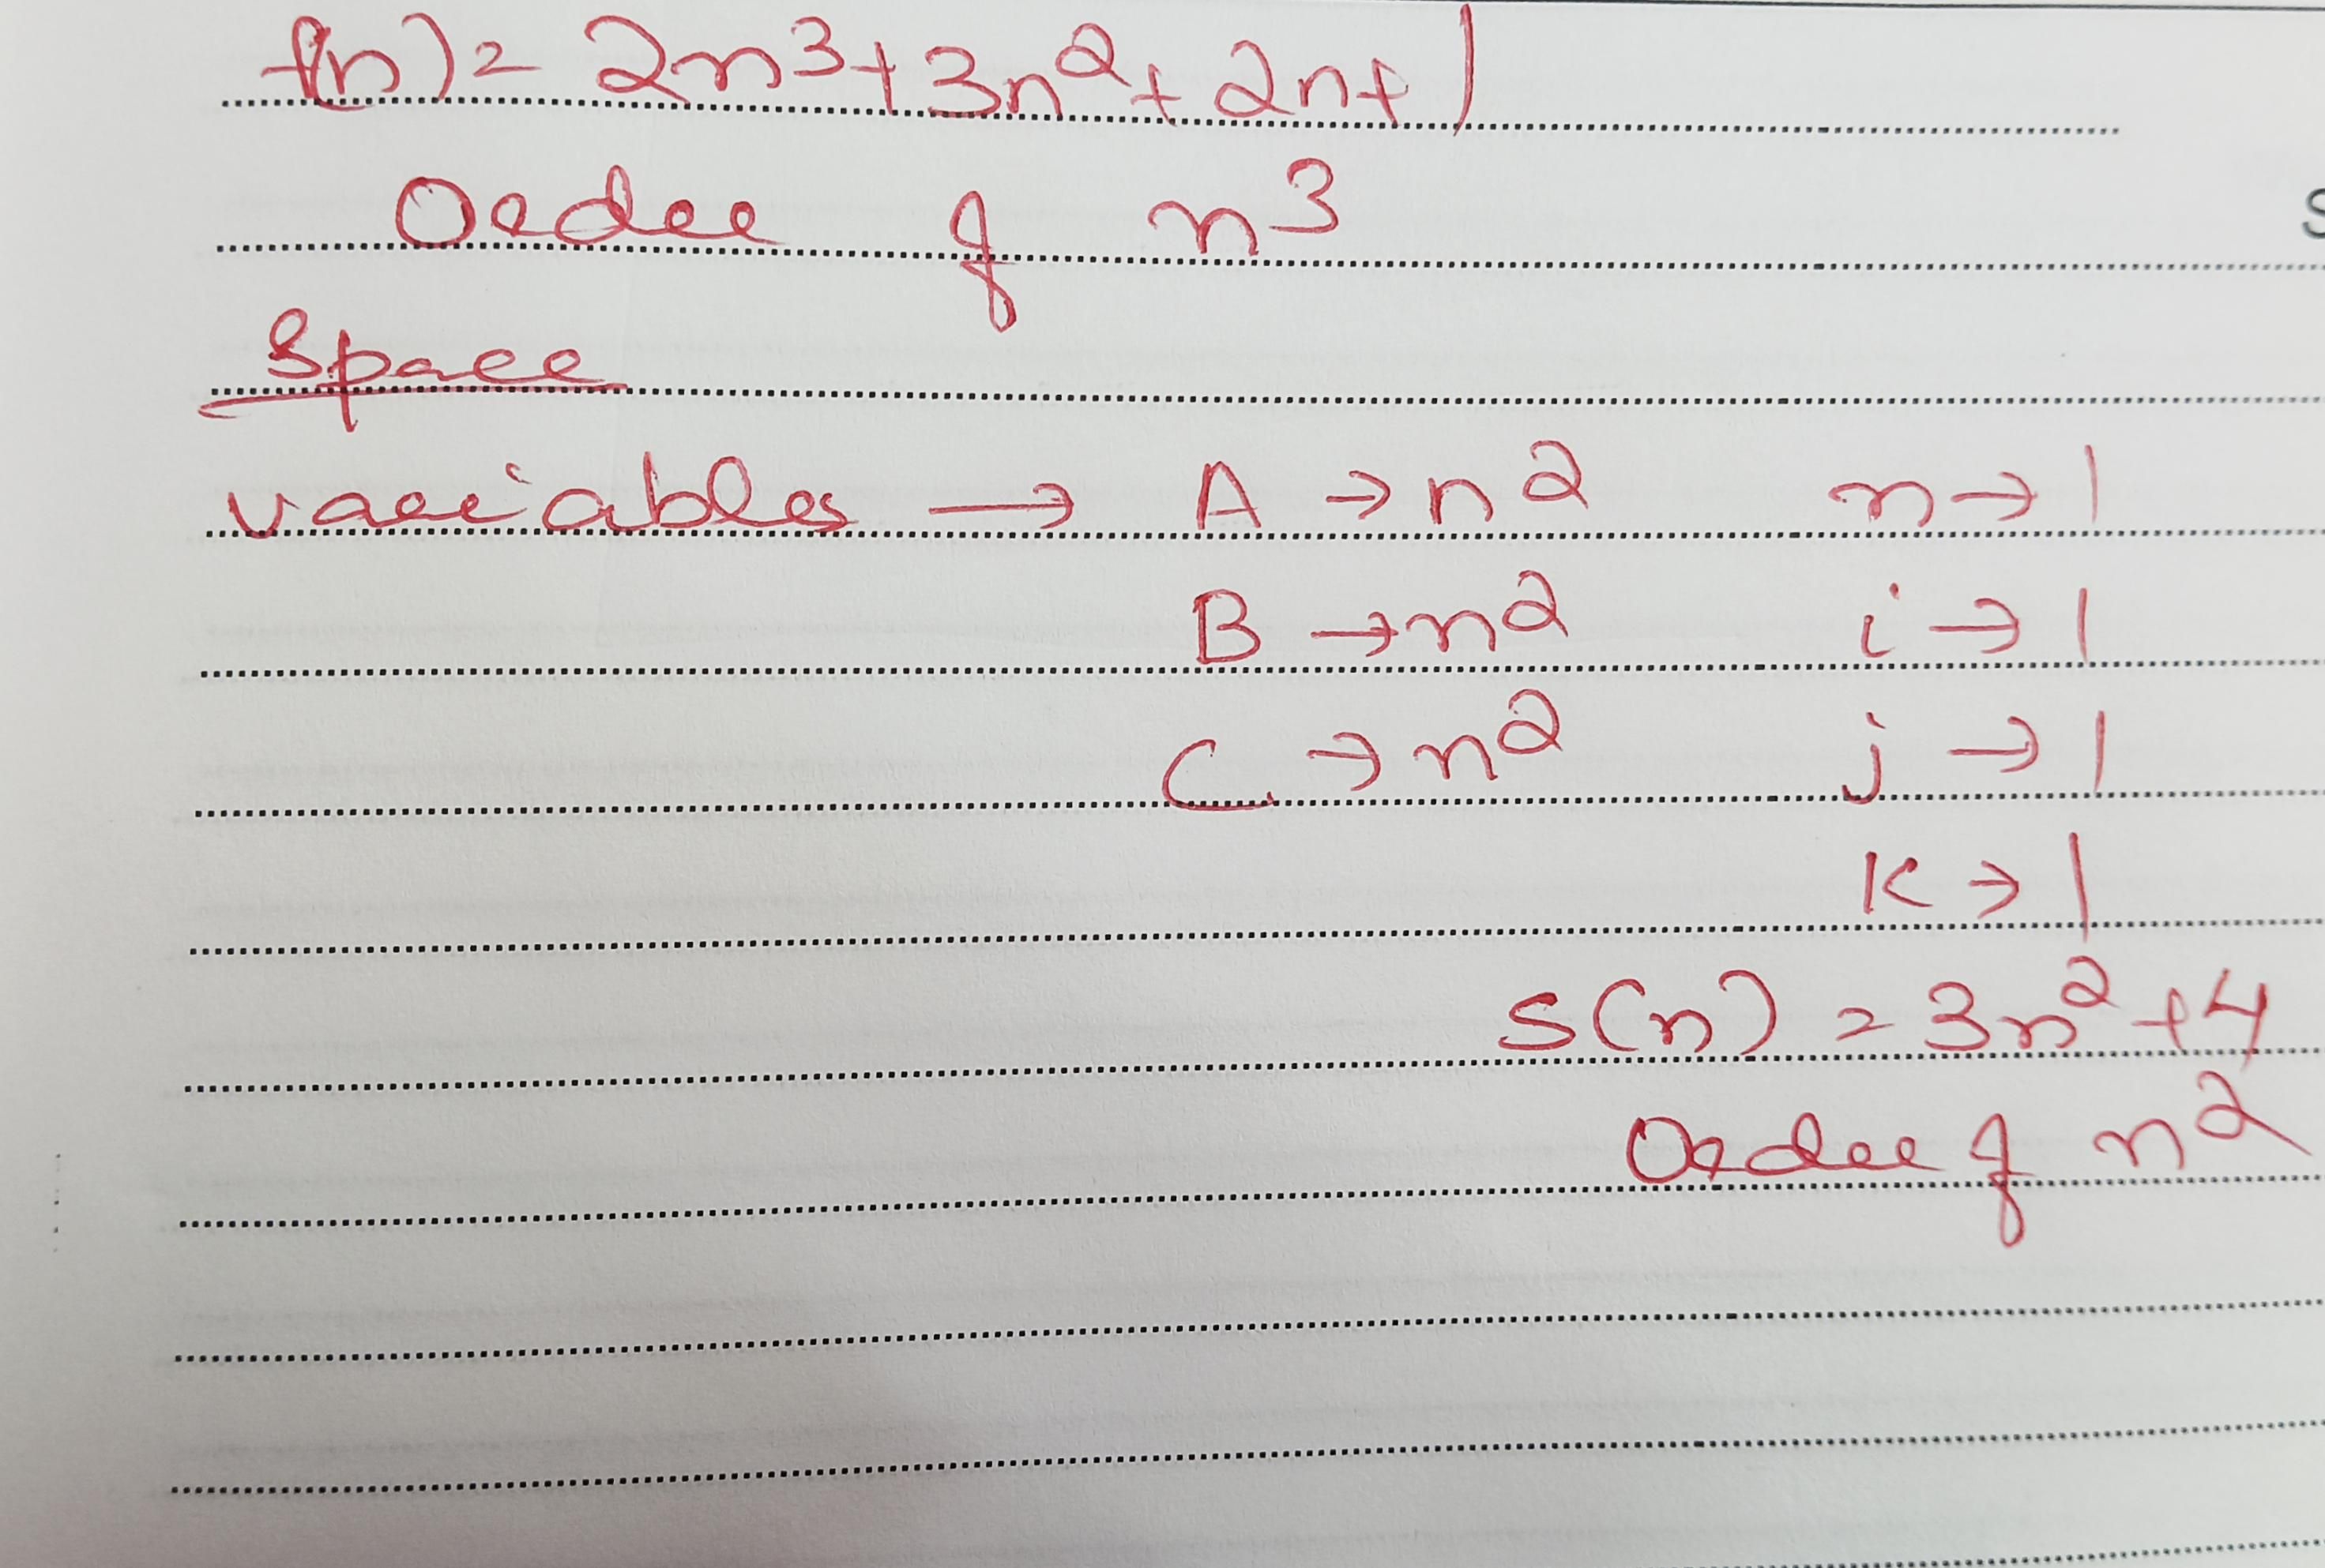
Example

Slide 15
Types of functions
O(1) –constant
O(logn) –logarithmic
O(n) –linear
O(n^2) –quadratic
O(n^3) –cubic
O(2^n) –Exponential
1<logn<√n<n<nlogn<n^2<n^3<2^n<n^n

Slide 16
Asymptotic Notations
mathematical notations used to describe the running time of an algorithm
Used to describe the running time of an algorithm – how much time an algorithm takes with a given input, n.

Slide 17
Big Oh Notation, Ο
Ο(n) is the formal way to express the upper bound of an algorithm’s running time.
measures the worst case time complexity or the longest amount of time an algorithm can possibly take to complete.
f(n) is O(g(n)), if for some real constants c (c > 0) and n₀, f(n) <= c g(n) for every input size n (n > n₀).

Slide 18
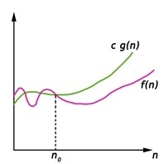
Big Oh Notation, Ο

Slide 19
Example
Consider the following f(n) and g(n)... f(n) = 3n + 2 g(n) = n If we want to represent f(n) as O(g(n)) then it must f(n) <= C g(n) for all values of C > 0 and n₀>= 1 f(n) <= C g(n) ⇒3n + 2 <= C n Above condition is always TRUE for all values of C = 4 and n >= 2. By using Big - Oh notation we can represent the time complexity as follows... 3n + 2 = O(n)

Slide 20
Omega Notation (Ω-Notation)
Execution time serves as a lower bound on the algorithm’s time complexity.
defined as the condition that allows an algorithm to complete statement execution in the shortest amount of time.
g and f be the function from the set of natural numbers to itself. The function f is said to be Ω(g), if there is a constant c > 0 and a natural number n0 such that c*g(n) ≤ f(n) for all n ≥ n0

Slide 21
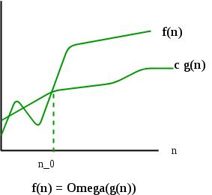
Omega Notation (Ω-Notation)

Slide 22
Omega Notation (Ω-Notation)
Function f(n) = 4n + 3and g(n) = n .
Now we need to see whether f(n) = Ω(g(n)) .
For that, we have to try and see whether we can find values for c and n0 where it will fulfil the condition if f(n) ≥ cg(n) for any n ≥ n0 where c, n are real numbers and c > 0 and n0 ≥ 1 then f(n) = Ω(g(n)).
If we are successful then we can say f(n) = Ω(g(n)) when f(n) = 4n + 3 and g(n) = n

Slide 23
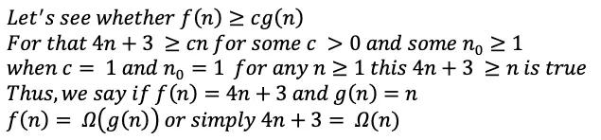
Omega Notation (Ω-Notation)

Slide 24
Theta notation (Θ-notation)
Theta notation encloses the function from above and below. Since it represents the upper and the lower bound of the running time of an algorithm, it is used for analyzing the average-case complexity of an algorithm.
Θ(g(n)) = { f(n): there exist positive constants c₁, c₂ and n₀ such that 0 ≤ c₁g(n) ≤ f(n) ≤ c₂g(n) for all n ≥ n₀ }

Slide 25
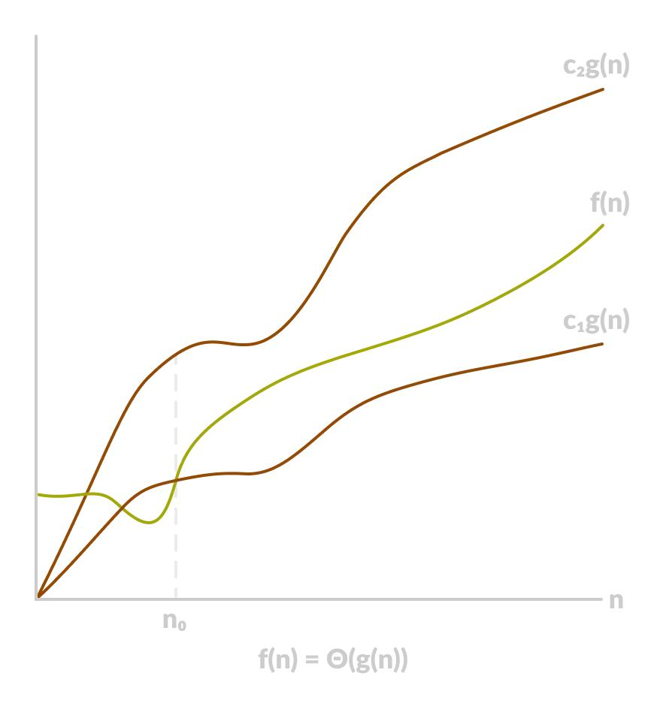
Theta notation (Θ-notation)

